Slide 1
Sales Order System
Done by
B.S.Sathya Swaroopa
CB.EN.U4CSE15348

Slide 2
Abstract
The objective of this project is to develop a database management system which is able to improve the functioning of a dedicated departmental store in terms of efficiency and also to increase the profit procured by the same. This particular system can add and evaluate records relating to the customers such as their name, address and keep track of the items purchased or orders placed by a particular customer. It can keep track of employees working at the store and orders handled by them likewise.

Slide 3
Abstract(contd)
It keeps track of the items available at the outlet, the items which are low on stock, so that the owner who has total access to the system is able to place orders correspondingly. Customers can raise service requests and each employee is assigned a particular group of customers which makes customer service easier. It provides information about the available products, details of customers and historical information about the products sold.

Slide 4
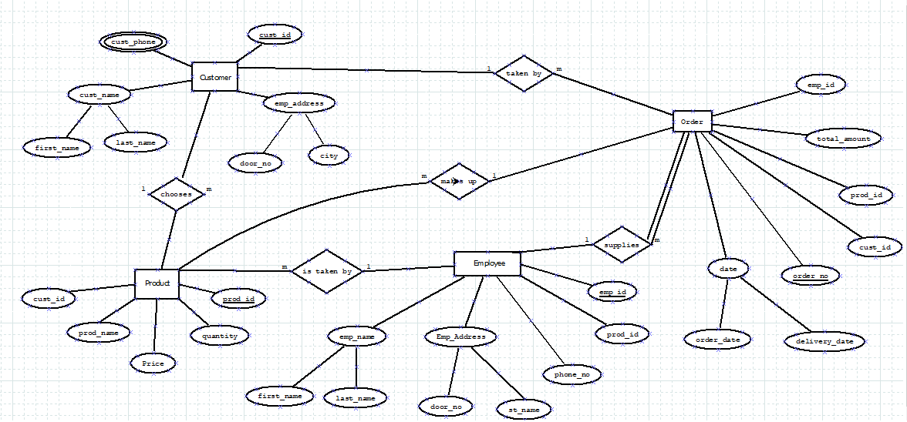
ER Diagram

Slide 5
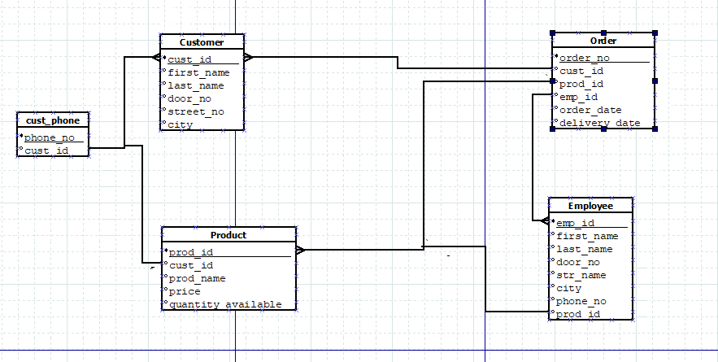
Schema

Slide 6
Entity List
Customer :- Contains the details of customers who are registered in the shop.
Employee :- Contains the details of the employees who are working in the shop.
Product :- Contains the details of the products in the shop with their quantity available.
Order :- Contains status of each bill, delivery information and the payment information.

Slide 7
Attributes
Customer(cust_imp,firstname,lastname,door_no,street_name,city)
Employee(emp_id,firstname,lastname,door_no,street_name,city,phone)
Cust_phone(phone_no,cust_id)
Product(prod_id,prod_name,cust_id,price,quantity)
Order(order_no,emp_id,prod_id,cust_id,order_date,deliver_date)

Slide 8
Relationship
There is a one to many [1:M] relation between employee and orders. One employee can handle many orders.
There is one to many [1:M] relation between customers and products as one customer can buy one or more products but each product associates to just one customer.
There is one to many [1:M] relation between order and employee as one employee can handle more than one order and order needs
There is one to many [1:M] relation between customer and order as one customer can place as many orders he desires and one order corresponds to only one customer.

Slide 9
Participation
Every Order needs an Employee to be proceeded but not every Employee need not necessarily handle an Order .Thus, it is a total participation for Order.

